Slide 1

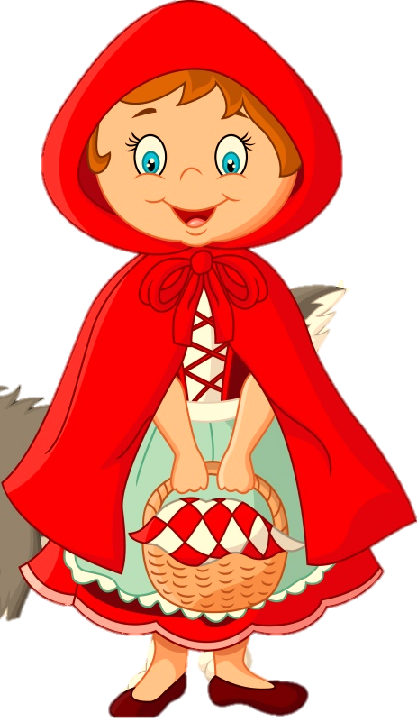
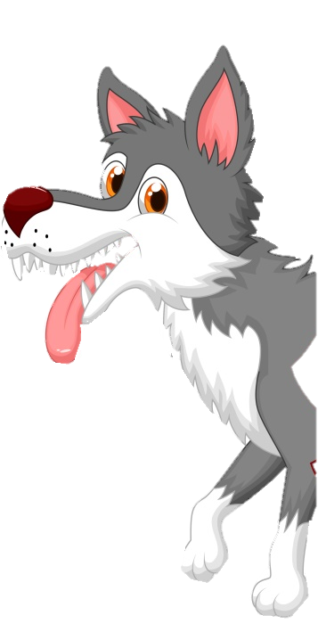
THE LITTLE RED RIDING HOOD

Slide 2


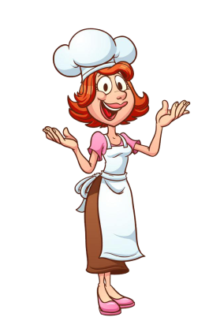
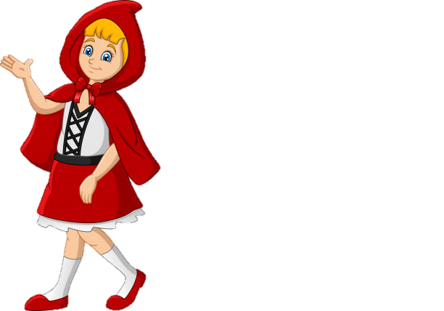
Little red riding hood lived in a hut near a forest with her mother.
She always wore a beautiful red hood while going out.

Slide 3
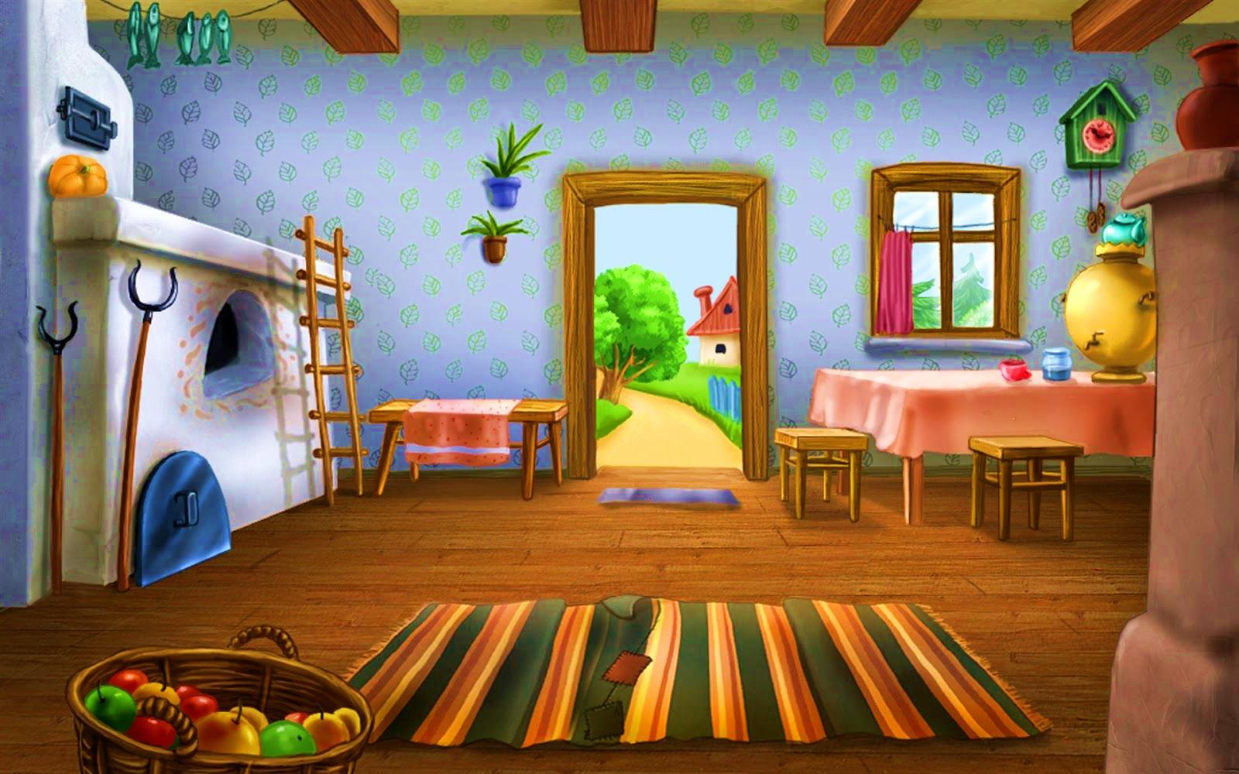
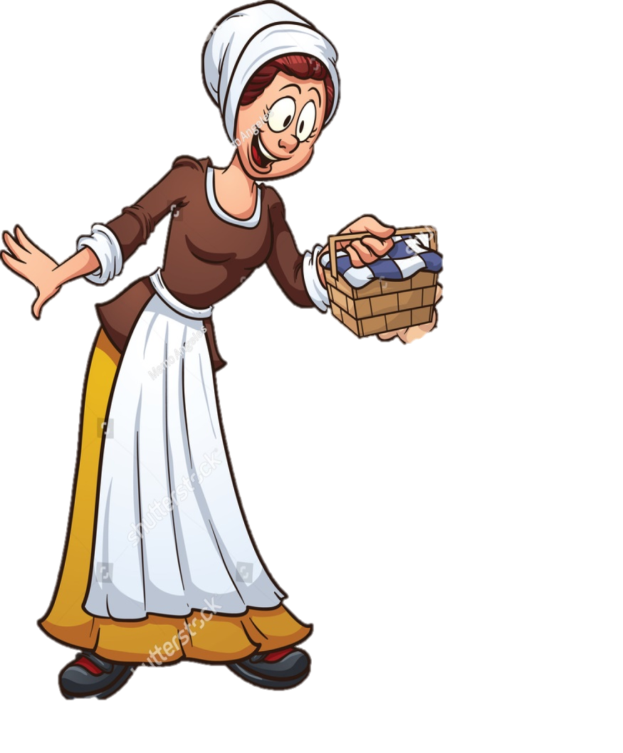
One day , her mother told that, her grandmother is not well.
So go and check whether she is doing well and gave this basket of food to her.
Suddenly ,she went to see her grandmother.

Slide 4

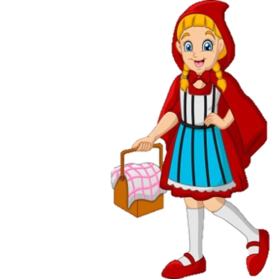




Little red riding hood did not have to worry about getting lost in the forest , because she knew the way to grandma’s house very well.
Along her way, she saw some beautiful wildflowers growing near the path. She took some flowers for her grandma.

Slide 5

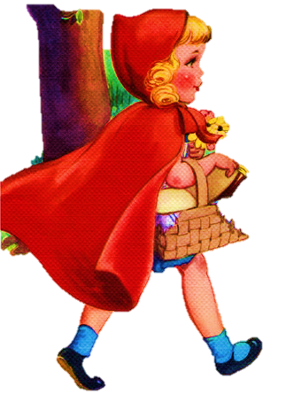
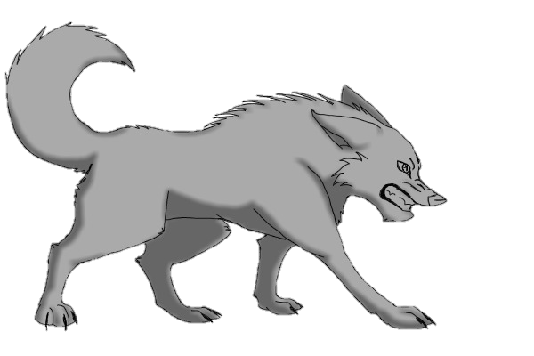
On her way ,she met a wolf.
I am going to see my granny. She lives behind that hill.
Hello! Where are you going?

Slide 6
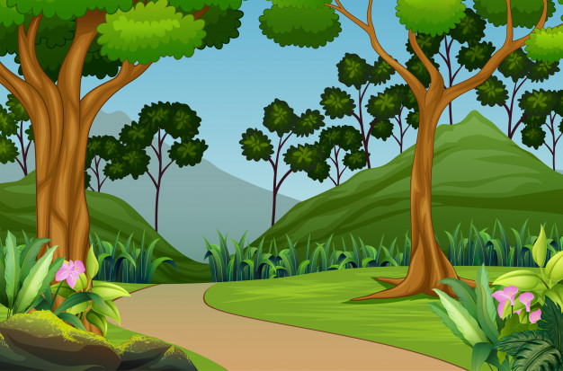
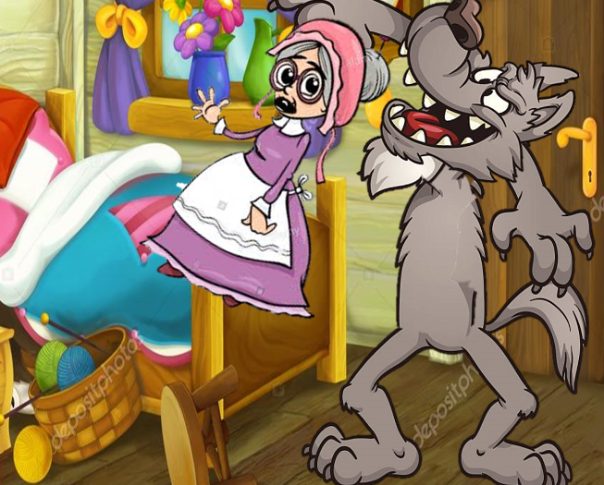
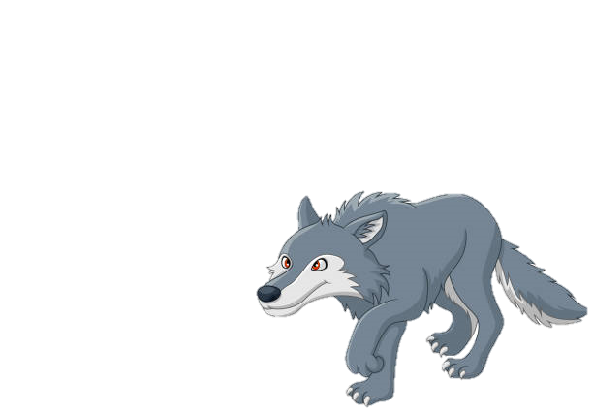
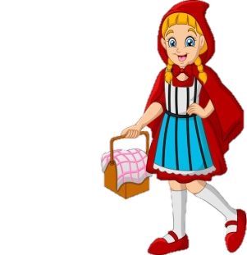
The wolf got a wicked idea and ran to grandma’s house.

Slide 7
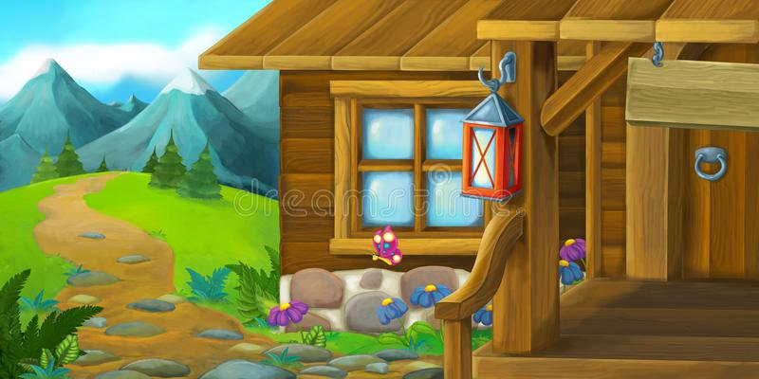
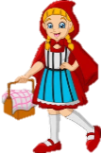
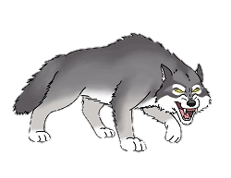
The wolf arrived at grandma’s house.

Slide 8

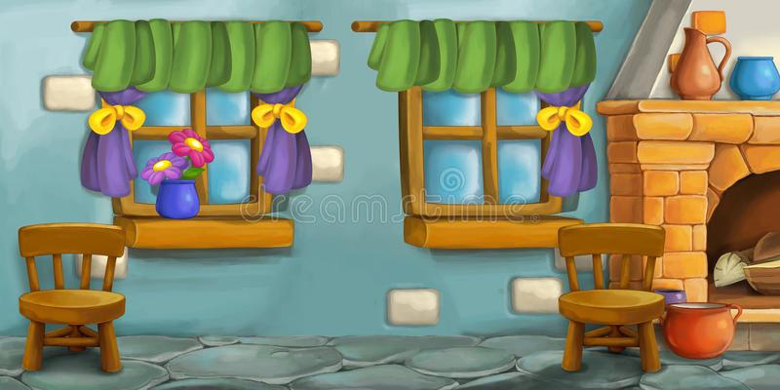
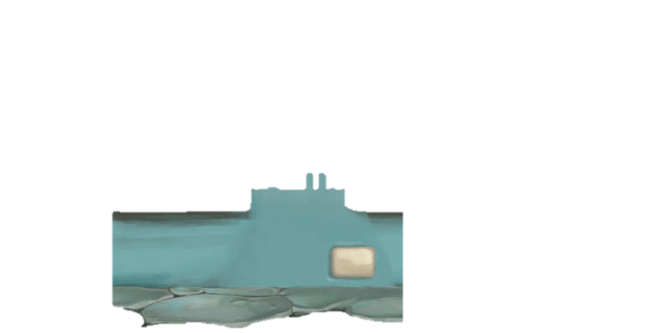
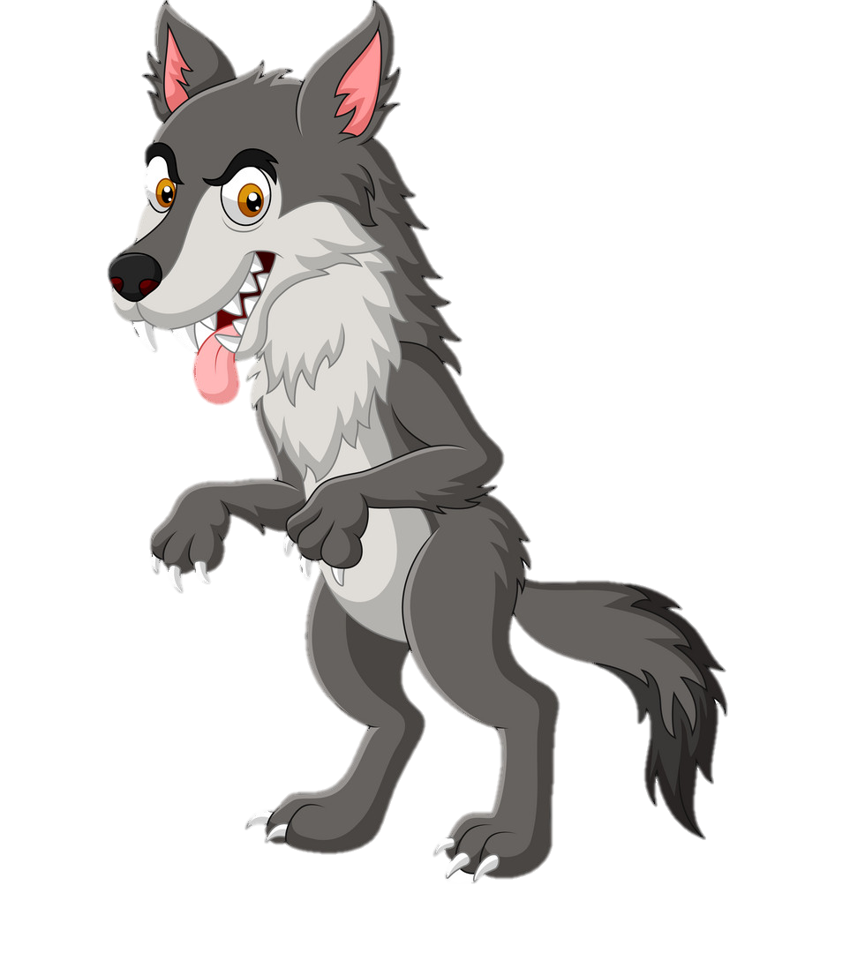
The sneaky wolf opened the door very quietly

Slide 9

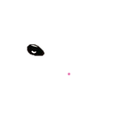
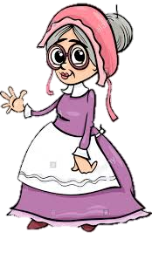
and found grandma on the bed.

Slide 10
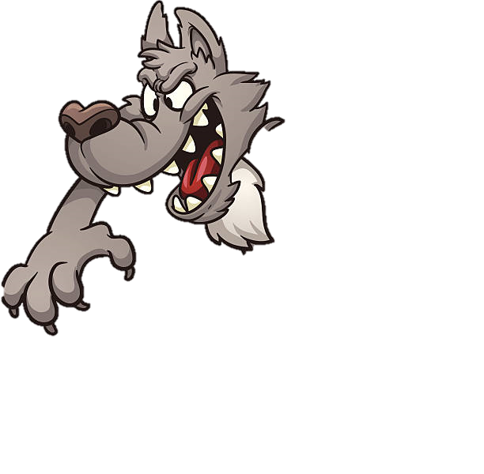
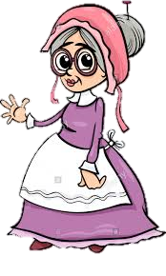
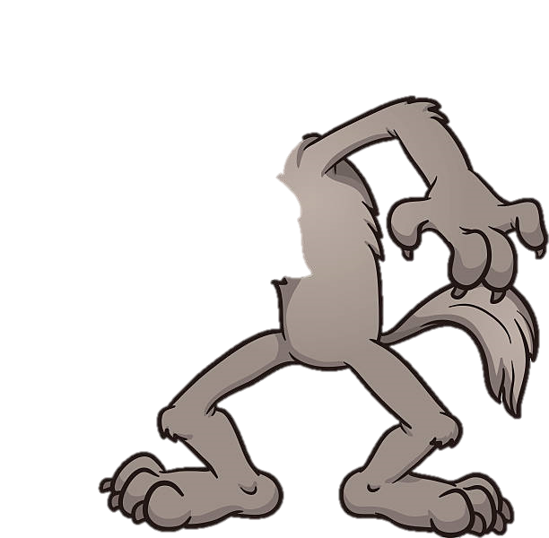
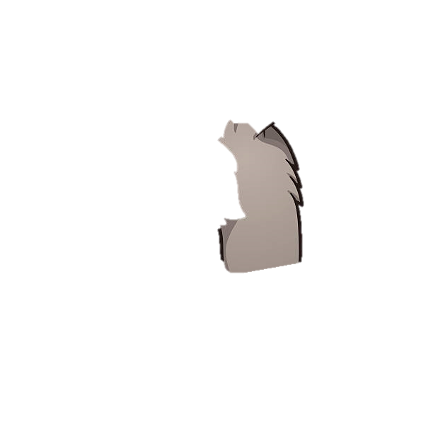
He picked the old women up and ate her up.

Slide 11
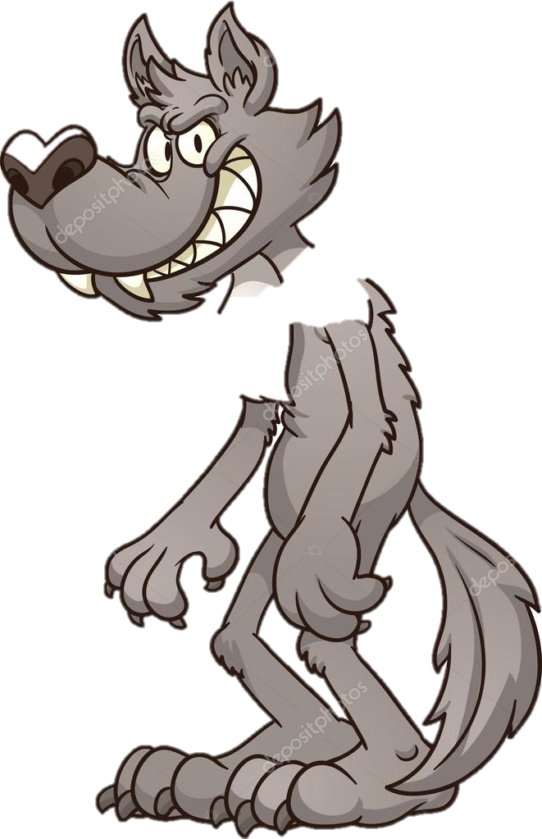
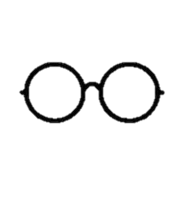
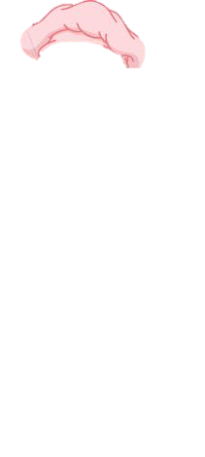
Then the big bad wolf climbed into the bed and pull the blanket up to his chin.
He put on grandma’s glasses and her nightcap.
He waited for the little girl to arrive.

Slide 12
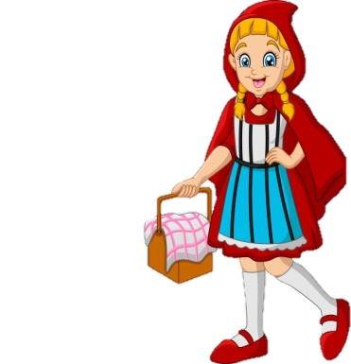
After sometime, the little red riding hood reached the house. She saw the wolf lying in her granny’s bed.
Hello! Grandma. How you doing ?
Come closer my dear

Slide 13
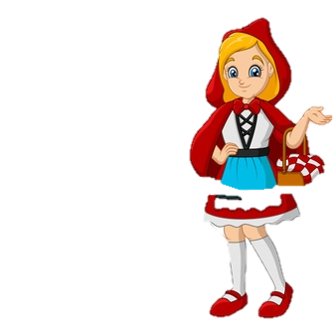
Oh Granny , what big eyes you have!
Granny , what big ears you have!
So that I can see you better!
Granny , what a big nose you have!
So that I can hear you better!
So that I can smell you better!
Oh Granny, what big teeth you have!
So that I can eat you better!

Slide 14
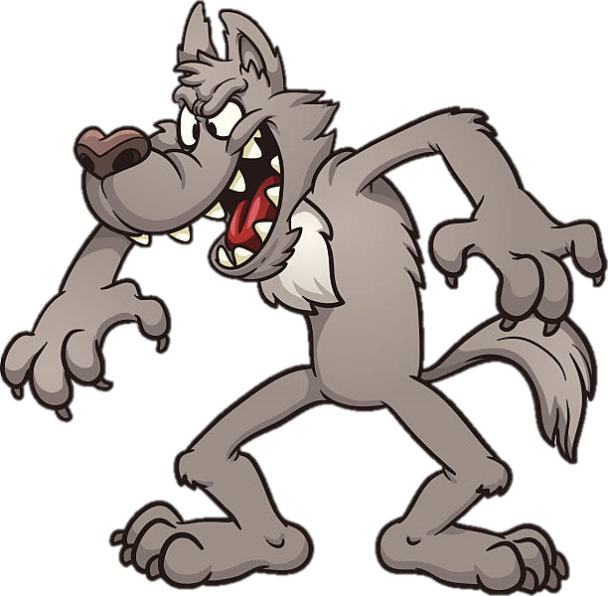
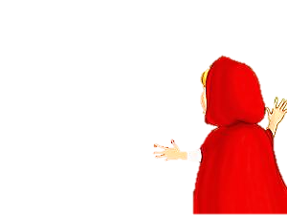
Oh my god!
Help me……
Help me……

Slide 15

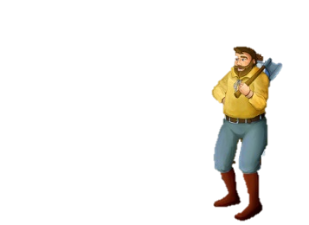
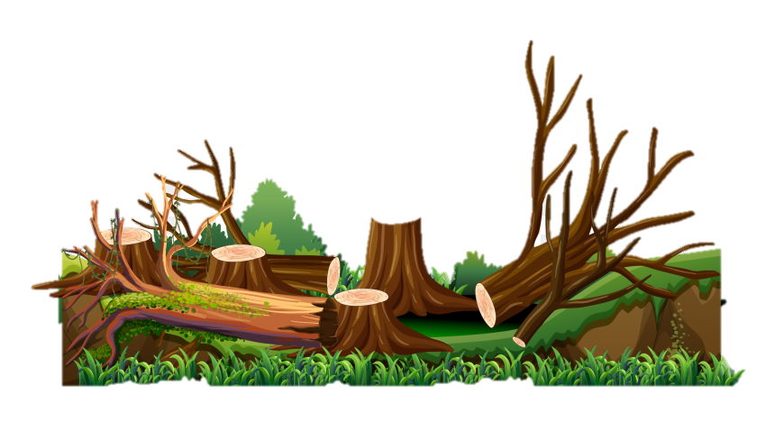

Help me……
Help me……
Nearby, a woodcutter was in the forest and he heard the scream.

Slide 16
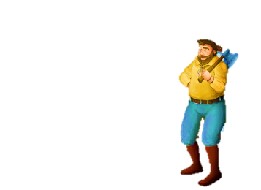
He ran to the house, just to see the wolf attacking the little girl.

Slide 17

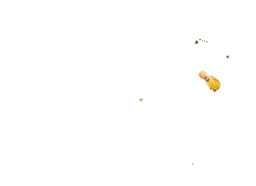
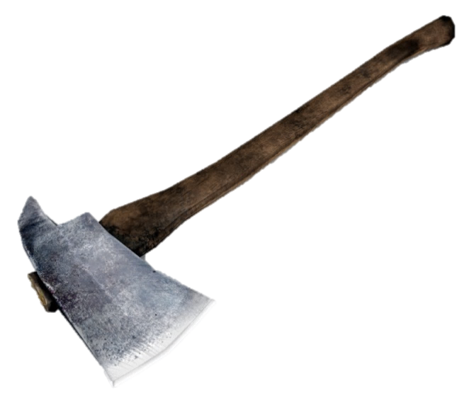
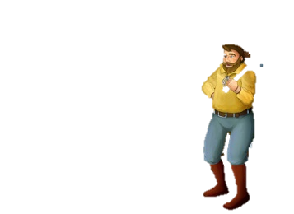
He hit the wolf over the head and this made the wolf open his mouth and shout.

Slide 18
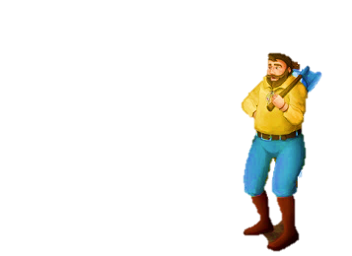
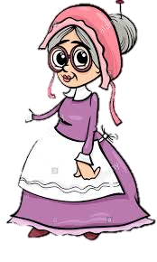
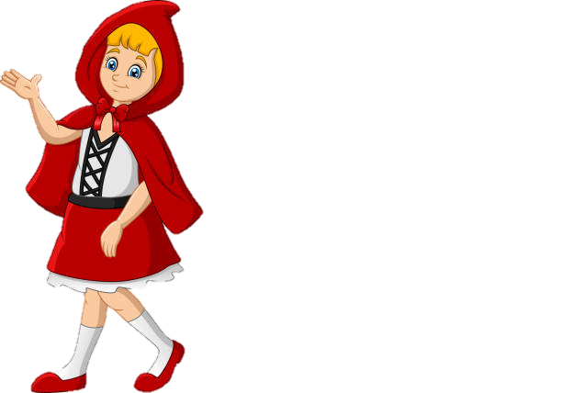
The granny jumped out.

Slide 19

The wolf ran away and little red riding hood never saw the wolf again.

Slide 20

THE END
By
Varsha Shaji

